Slide 1
Realtime Environmental Monitoring with Raspberry Pi Microprocessor and Microcontrollers Practice Department of ECE IIITDM Kurnool
December 2024 – April 2025 D. Sajid Ali(123EC008)

Slide 2
Outline
Objective
Scope
Introduction
Equipment/Tools Used
Detailed Description of the Project
Results and Discussions
Summary

Slide 3
Objective
To implement a real-time environmental monitoring system using Raspberry Pi.
Integrating temperature, humidity, and air quality sensors.
With secure data handling techniques, including encryption and masking.

Slide 4
Scope
IoT-based real-time environmental monitoring.
Secure data transmission and storage.
Correlation analysis for better environmental insights.
Can be applied in smart homes, industrial monitoring, and research

Slide 5
Introduction
The rapid advancements in technology have enabled smart environmental monitoring systems that can provide real-time data for analysis and decision-making.
Environmental factors such as temperature, humidity, and air quality play a crucial role in various applications, including industrial automation, healthcare, and smart cities
This project focuses on developing an efficient monitoring system using Raspberry Pi , interfacing it with sensors, and ensuring secure data handling.
The system is designed to collect data from multiple sensors, process it, and store it securely while enabling real-time monitoring and correlation analysis.

Slide 6
Introduction
Additionally, data security is a critical aspect of modern systems, and this project incorporates encryption and masking techniques to ensure secure storage and transmission.
The implementation of correlation analysis provides valuable insights into environmental changes and their impact, making the system a useful tool for research and practical applications.

Slide 7
Introduction
This project enables real-time data acquisition and analysis.
This experiment utilizes a Raspberry Pi to collect, store, and analyze environmental data securely.
Data security is enhanced using encryption and masking techniques.

Slide 8
Equipment/Tools Used
Hardware:
Raspberry Pi 4
DHT11 (Temperature & Humidity Sensor)
MQ-135 (Air Quality Sensor)
MCP3008 (ADC)
Power Supply
Software:
Python
SQLCipher (for encryption)
Matplotlib (for data visualization)
ThingSpeak (for cloud monitoring)
Twilio API (for SMS alerts)

Slide 9
Detailed Description of the Project
Hardware Setup: The Raspberry Pi serves as the main controller that interfaces with sensors to collect environmental data.
Data Processing and Security: The collected data is processed and securely stored in an encrypted database.
Analysis and Alerts: The system analyzes data trends and triggers alerts based on predefined conditions.
SMS Notification System: Critical alerts are sent to users via SMS using the Twilio API.

Slide 10
Detailed Description of the Project
Hardware Setup:
The DHT11 sensor is connected to GPIO4 (Pin 7) of the Raspberry Pi to collect temperature and humidity data.
The MQ-135 sensor detects air quality and outputs an analog signal, which is converted into a digital format using the MCP3008 ADC.
The MCP3008 ADC is connected to the SPI pins of the Raspberry Pi, allowing it to read multiple sensor inputs simultaneously.
A power supply ensures stable operation of all components.

Slide 11
Detailed Description of the Project Contd…
Data Collection & Storage:
A Python script reads sensor values at regular intervals.
The collected data is encrypted using SQLCipher before being stored in an SQLite database.
Secure transmission is achieved using API keys and MQTT with TLS encryption.
Data masking techniques are applied to prevent exposure of sensitive values

Slide 12
Detailed Description of the Project Contd…
Data Analysis:
Correlation analysis is performed using the Pearson correlation coefficient to determine relationships between temperature, humidity, and air quality.
The analysis results help in understanding environmental trends and variations.
Graphical visualizations are created using Matplotlib to represent data insights effectively.

Slide 13
Detailed Description of the Project Contd…
Alert Mechanism & SMS Notification System:
The system continuously monitors temperature levels and triggers an alert if the values exceed a predefined threshold.
Alerts are sent to the cloud platform (ThingSpeak) and can be accessed remotely.
A Python script integrates with the Twilio API to send SMS notifications to registered phone numbers when critical environmental thresholds are breached.
The SMS system ensures real-time alerts, providing immediate response capability for users.

Slide 14
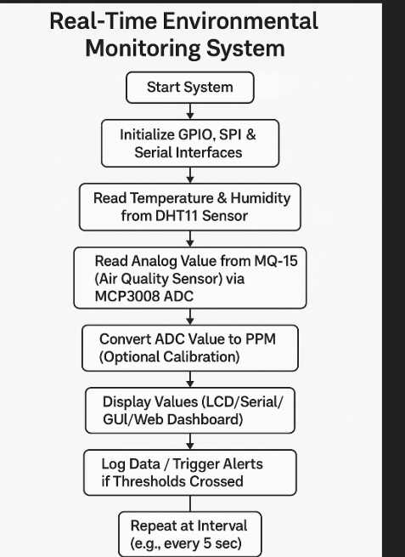
Detailed Description of the Project Contd…
System Initialization: GPIO, SPI, and serial interfaces are set up on the Raspberry Pi.
Sensor Data Acquisition: Temperature and humidity are read from the DHT11 sensor, and air quality data from the MQ-135 via MCP3008 ADC.
Processing & Output: Sensor data is converted, displayed, logged, and alerts are triggered if threshold values are crossed.

Slide 15
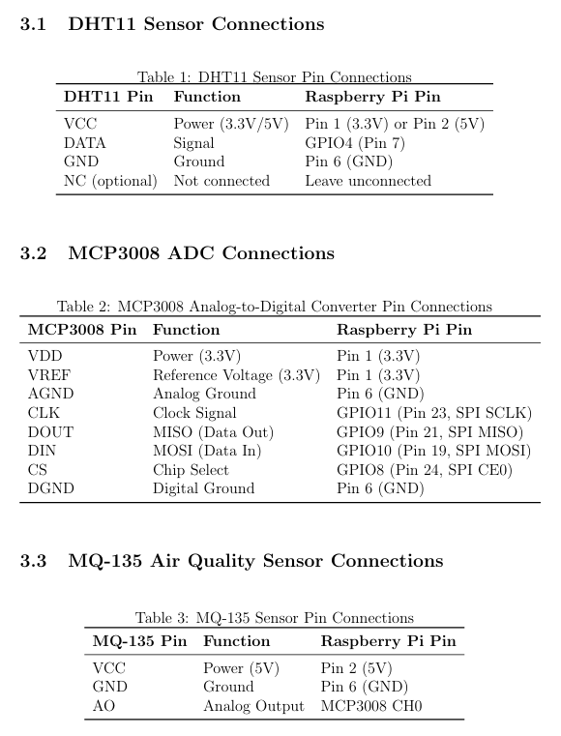
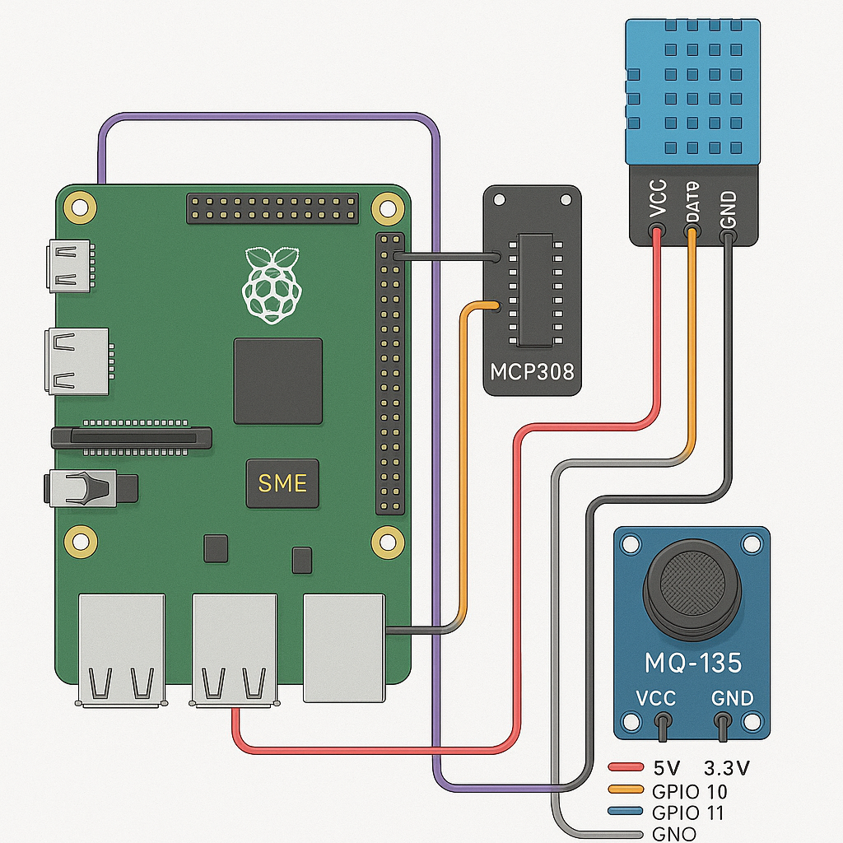
Detailed Description of the Project

Slide 16
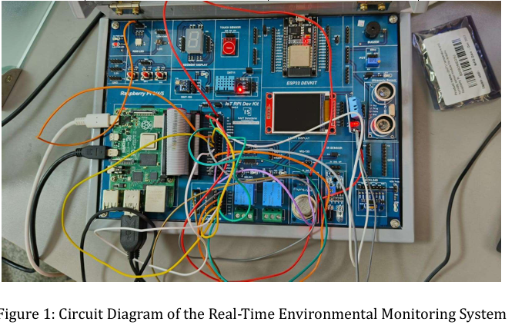
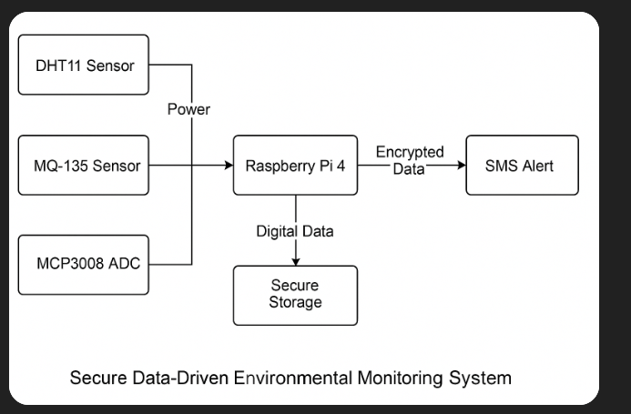
Detailed Description of the Project Contd…

Slide 17
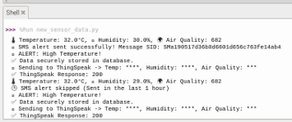
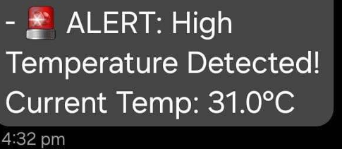
Results and Discussions
Outputs:
SMS alert:

Slide 18
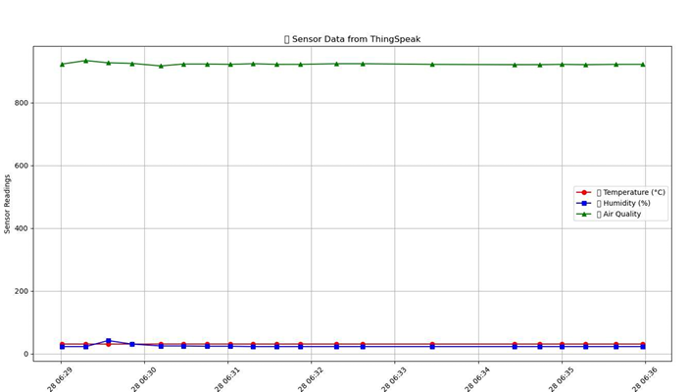
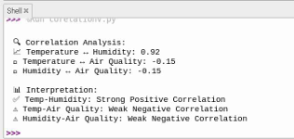
Results and Discussions Contd…
Correlation Analysis:
Graph using Matplot lib:

Slide 19
Results and Discussions Contd…
The system reads sensor data (Temperature, Humidity, Air Quality) and triggers alerts for high temperature.
SMS alerts and ThingSpeak updates are intelligently managed to avoid redundancy within a 1-hour window.

Slide 20
Summary
Implemented an IoT-based environmental monitoring system.
Secure data handling using SQLCipher and masking.
Correlation analysis provides insights into environmental trends.
Successful alert triggering and secure data transmission.
Implemented SMS notifications using Twilio API for critical alerts.

Slide 21
References
Internet of Things: Principles and Applications - Wiley
Raspberry Pi IoT Projects - Packt Publishing
Sensor Interfacing with Raspberry Pi - Springer
Secure Data Storage Techniques - IEEE Xplore
Gastón C. Hillar. Building Arduino Projects for the Internet of Things: Experiments with Real-World Applications. Apress, 2016.

Slide 22
Thank You

